Slide 1
עִבְרִית
Lesson 4
ל
Our new letter of the week is:
Notes:
Ask students is any of them recognize this letter. What is it?

Slide 2
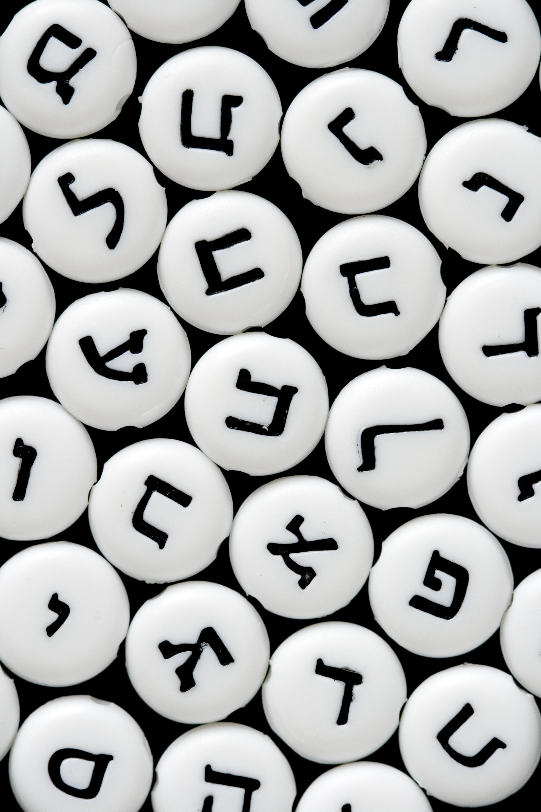
Agenda
Hebrew and TPR Review
Meet the Letter Tav
Reading practice I
BRAIN BREAK
Writing practice
Reading Practice II
Four Quarters
Next week and Homework

Slide 3
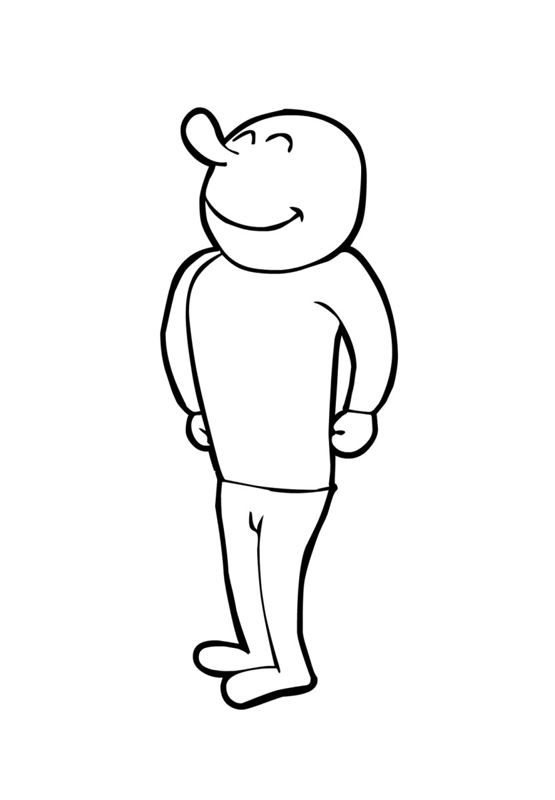
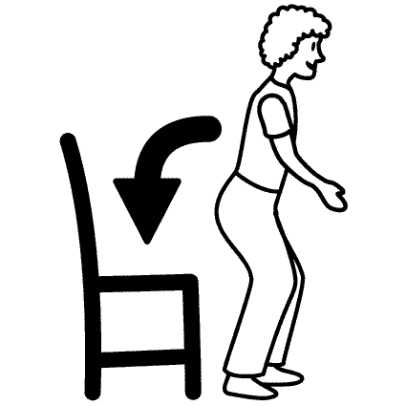
Review: Total Physical Response
Notes:
Simply and briefly review what each word means

Slide 4
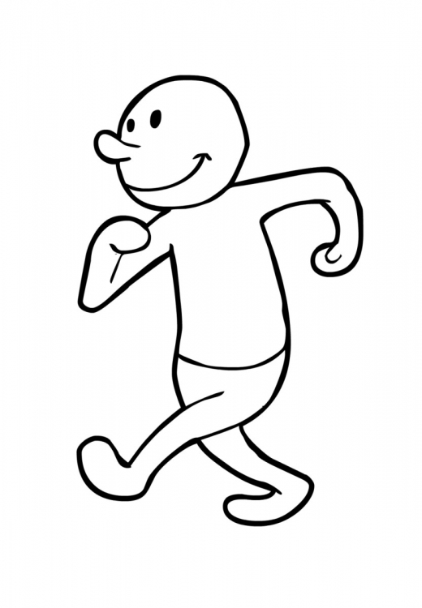
Review: Total Physical Response
Notes:
Simply and briefly review what each word means

Slide 5
Review: שַׁ, בָּ, ת
If a word starts with…
שׁ:
Any other letter:
Good Luck!
מ:
:בּ
Notes:
Play this pseudo-modified version of Simon Says. Before class prepare 10-20 Hebrew words printed on cards. Most should start with shin, bet, tav, and/or the “ah” vowels.
שׁ: When the word shown starts with a “shin" לָקוּם
בּ: When the word shown starts with a “bet” לָשֶׁבֶת
ת: When the word shown starts with “tav” לָלֶכֶת in place
When the word shown starts with either of the “ah” vowels we have learned, please לַעֲצוֹר instead of any other command.
If the word starts with any other letter or vowel do nothing.

Slide 6
Meeting the Letter ל and the vowel וֹ
What are some words you can think of that start with the sound “Lo”?
Can you think of any Hebrew words that have a lamed in them?
What about the vowel “oh”?
Notes:
Ask the students to come up with answers for the questions above if they can (tell them to THINK BACK TO ANY PRAYERS THEY KNOW and the TPR WORDS to help with the questions about Hebrew—example: the word Olam). Each student should write down their answers and then share them together.

Slide 7
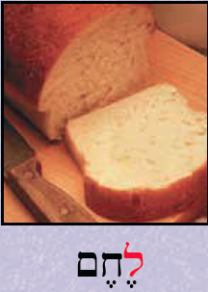
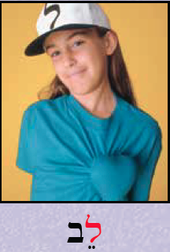
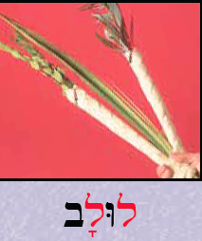
Meeting the Letter ל
How many LAMEDs are on this slide?
Notes:
Read each word and have the students repeat after you. Ask students what they think each word means based on the pictures. What blessing do we say over “lechem”? When are we NOT allowed to eat “lechem”? What emotion is often associated with a “lev”? What holiday do we use a “lulav” on? What do we do with a “lulav”?

Slide 8
Reading Practice
Notes:
Read lines 1 and 2 everyone together. Lines 3 and 4 read “popcorn” or such that every student reads one word in a cycle.

Slide 9
Reading Practice
Notes:
For lines 5-8 ask students to find all of the shin, bet, tav, and lamed. How many of each are there? Give every student a different color. Pick a word on the page and ask students to circle it. Whoever circles it first gets to choose the next word for the students to circle. For words that have multiple spelling/appearances on the page (such as “lah”), circling any of them is correct.

Slide 10
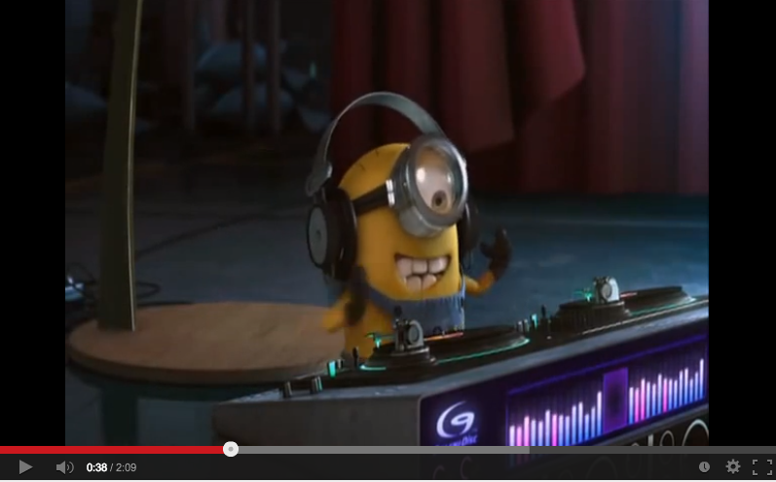
BRAIN BREAK!!!
Notes:
YOU SHOULD BE DANCING, YEAH!!!
http://safeshare.tv/w/ZUWURdPvrg

Slide 11
Lets Practice WRITING!
Get out a pencil and paper. On your paper start practicing writing the letter. One by one I’ll have you show me your work by holding your paper to the camera.
1
ל
2
3

Slide 12
More Reading Practice: וֹ
כָּל הַעוֹלָם כֻּלּוֹ גֶּשֶׁר צַר מְאֹד,
וְהַעִקָּר לֹא לְפַחֵד כְּלָל
The whole world
is a very narrow bridge -
A very narrow bridge.
And the main thing to recall -
is not to be afraid -
not to be afraid at all.
Notes:
Have students
Find and circle all of the “oh” vowels. Then read those words with them. Point out to the students that sometimes, as in meod, and lo, the vav does not appear in the word and the dot is simply placed over the next letter. This still makes an ‘oh’ sound.
Find and square all of the “lamed”s. Then read those words with them.
Find any other letters we have learned.
Sing the song “Gesher Tzar M’od” with the recording (http://safeshare.tv/w/cclrDgbfCw)
URL: http://safeshare.tv/w/cclrDgbfCw
You’ll have to open the URL yourself

Slide 13
More Reading Practice: וֹ
Notes:
Read lines 1 and 2 together. Then have students play a game of their choice from this (http://www.purposegames.com/search?q=hebrew) website while you listen to students read individually.

Slide 14
The Four Quarters of Jerusalem
Notes:
Ask students to read the passage above. Have they ever been to Israel? Jerusalem?

Slide 15
Next Week!
We will review the letters we have already learned and our “Total Physical Response” words.
We will learn the letter Mem מ and the Ee vowel.
Before Next Class
Complete Lesson 4: The Letter Lamed on My.ShalomLearning.org

