Slide 1
בָּרְכוּ
Barekhu
“Bless Adonai, the praised, forever”

Slide 2
Agenda
Background
  Find the Barekhu
  Discussion Questions
  Introduction Video
Barekhu
  Reading and Chanting
  Find the Root
  Translate
How to Dance the Barekhu
The First Barekhu
Practice Bowing
Being a Community
The Power of a Minyan

Slide 3
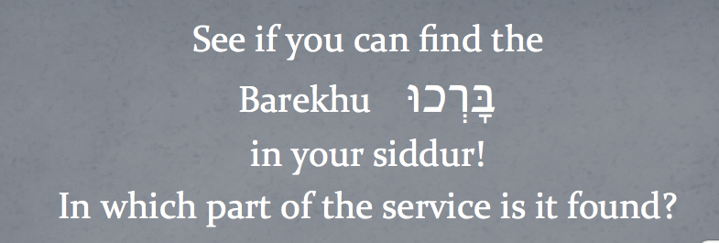
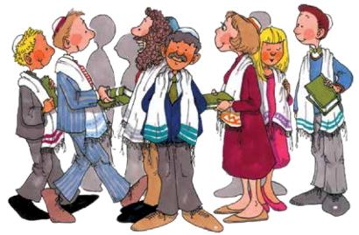
See if you can find the
Barekhu בָּרְכוּ
in your siddur!
In which part of the service is it found?
Notes:
The Barekhu is at the beginning of the main section of the service, just after the Pezukei d’Zimra (or preliminary prayers).

Slide 4
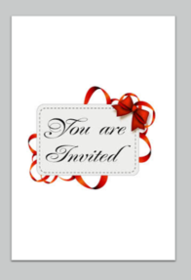
Invitations
For which kind of events have you sent or received invitations?
How were the invitations sent? Did the invitation require a reply?
Did you ever receive a really great invitation? What made the invitation great?
Notes:
Use these discussion questions to encourage students to begin to formulate a familiar connection to the theme of the prayer.

Slide 5
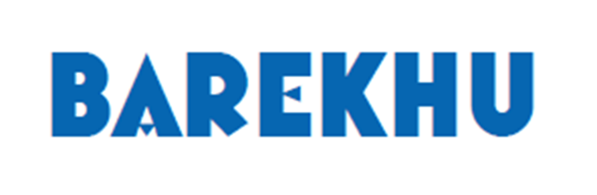
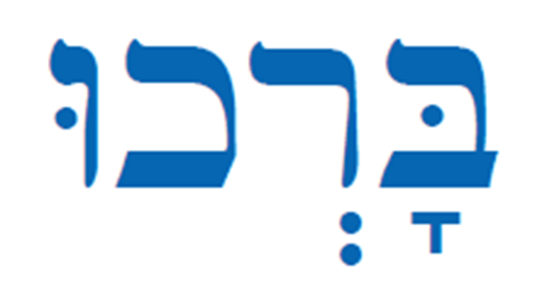
The Invitation to
Become a Community

Slide 6
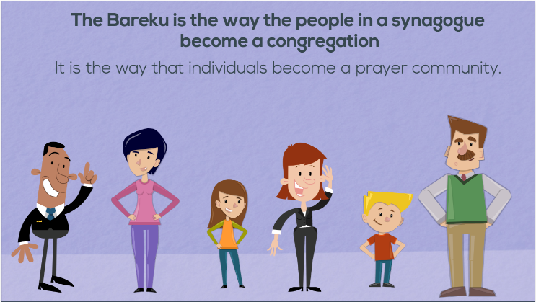
Introduction Video
Notes:
Play the video for background information and an introduction to the themes of the prayer.
You can click on the play button or download the video file from My.ShalomLearning.org.
These links are for reference
https://safesha.re/26i
https://vimeo.com/281330145

Slide 7
Barekhu
Lets learn to read and chant the Barekhu!

Slide 8
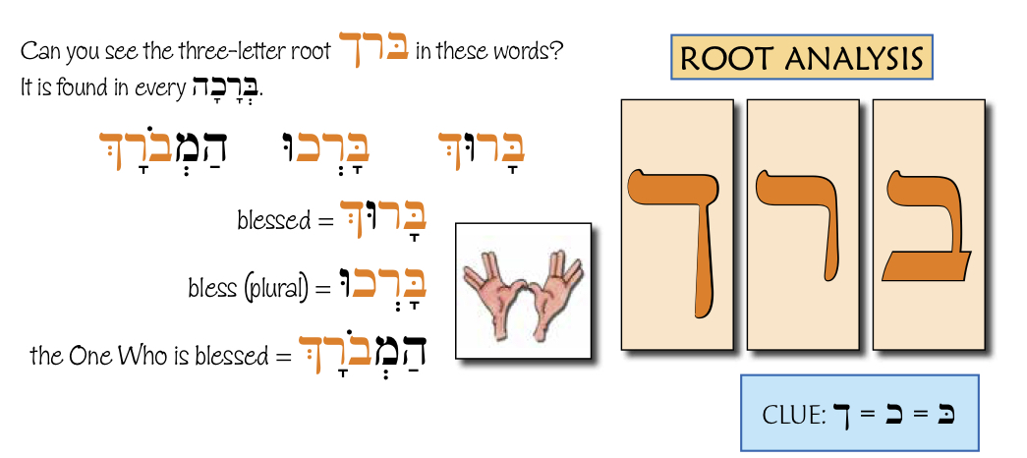

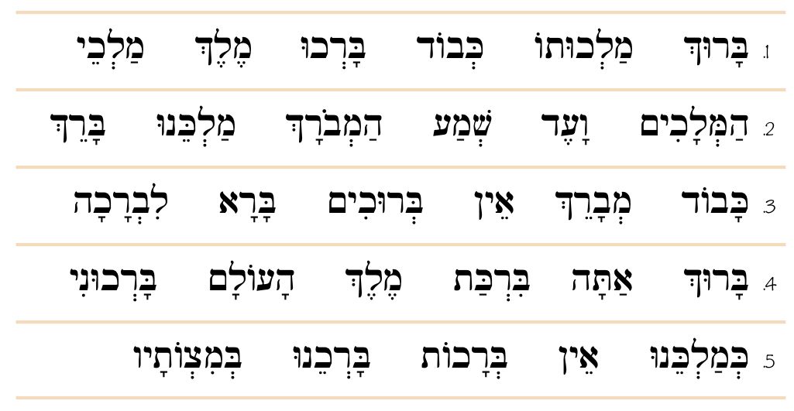
Root Analysis
Practice these words and circle all the ones that contain the root:
Notes:
Teach the important root words and identify them in different forms. Answers on the next slide.

Slide 9
Root Analysis ברך

Slide 10
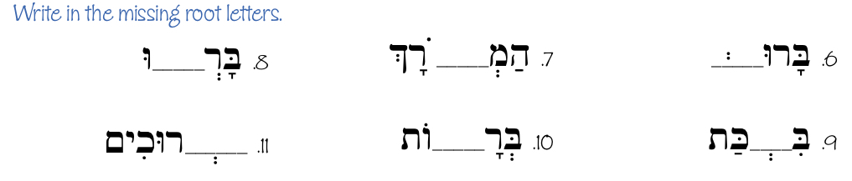
Barekhu: Root Analysis
Notes:
(final chet) ך
ב
כ
(resh)ר
כ
ב

Slide 11
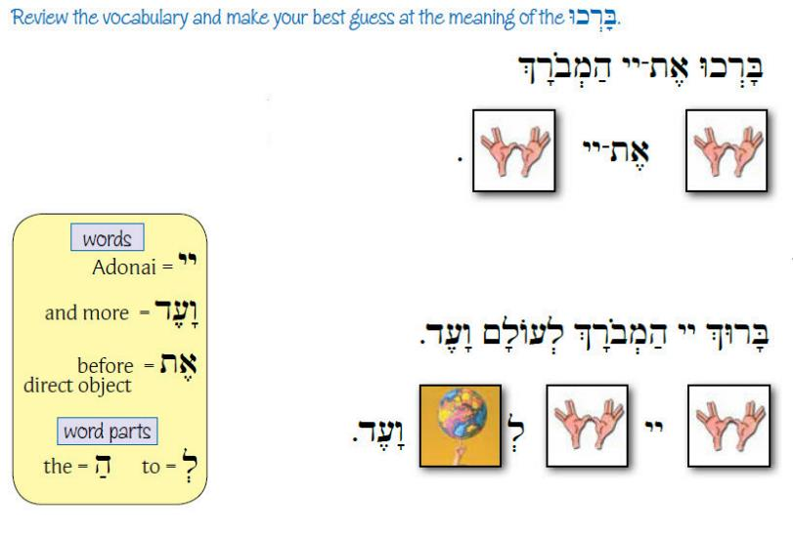
Guess the Translation
Notes:
Blessed is Adoani, the One Who is Blessed
Bleesed is the One Who is blessed for ever and ever.

Slide 12
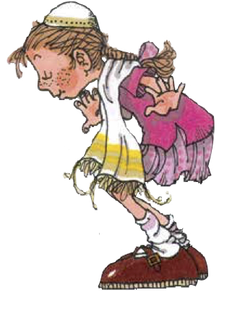
How to Dance the Barekhu
Notes:
You can click on the play button or download the video file from My.ShalomLearning.org
These links are for reference.
https://safeshare.tv/x/ss5af4a4fb77c62#edit
https://vimeo.com/265459986

Slide 13
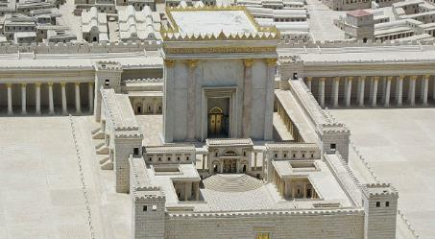
The First Barekhu
Jewish people used to gather on a mountain in Jerusalem to worship and feel close to God. All the Jews would go to the Temple three times a year. At those times, Jews felt like they really belonged, and at those moments, God felt very close. Then it was over.
The Babylonians conquered Jerusalem, and the Temple was destroyed and left in ruins. The Jews were carried away as slaves, and the mountain where the Jews had gathered was empty. Israel was in exile.
Notes:
Read the story together. Students can take turns reading to make the story more interactive. Discussion questions follow.

Slide 14
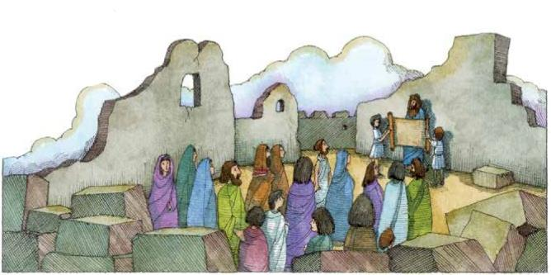
It took seventy years for the Jewish people to receive permission to return. At first, only a few Jews left their new homes and their new businesses to become pioneers. They began to rebuild the Land of Israel and the Temple, but it did not go well. There were many problems.
Then, two new leaders, Ezra and Nehemiah, came from Babylonia. They held an eight-day festival in the center of the unfinished Temple courtyard to bring the people together. For three of those days, for the first time ever, the Torah was read from beginning to end.

Slide 15
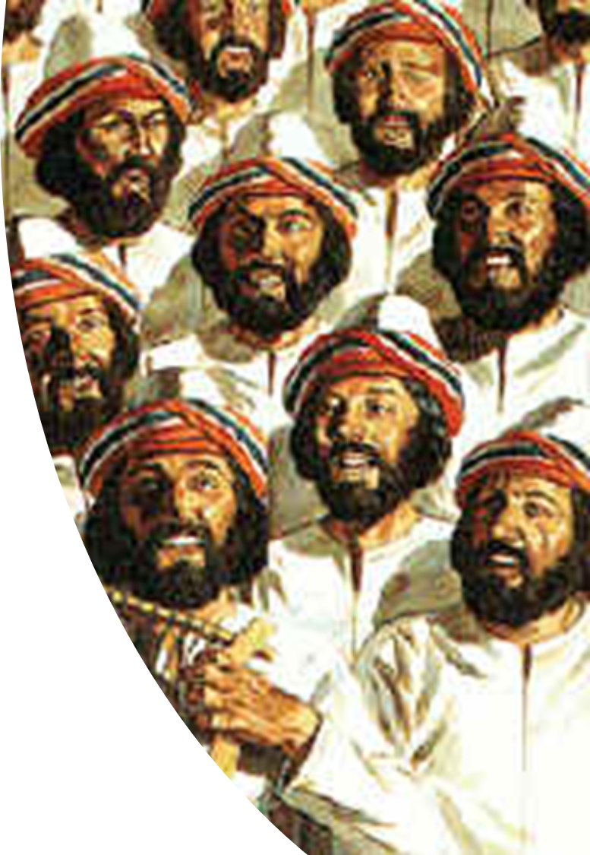
At the beginning of this eight-day festival, when everyone was standing in the unfinished courtyard waiting to see what would happen, the Levites went up on the stage. The Levites were the singers and musicians who led services in the Temple. They broke the silence with words that were more or less the Barekhu. The people answered with their part. When this Barekhu ended, the exile was over. Israel was again one people, and they again had a home.
(Reuven Hammer's book, Entering Jewish Prayer, A Guide to Personal Devotion and the Worship service)

Slide 16
Discussion Questions
How did saying the Barekhu end the exile?
How can remembering this first Barekhu in the unfinished Temple help us to know where to point our hearts when we say the Barekhu?
Bonus question: This story tells us that everyone would go to the Temple three times a year. Can you guess what those three times were?

Slide 17
Barekhu
I need a volunteer to read these lines slowly out-loud to the class
Every time a word with the root .ב.ר.כ appears, everyone else has to bow. See if you can hear them all.

Slide 18
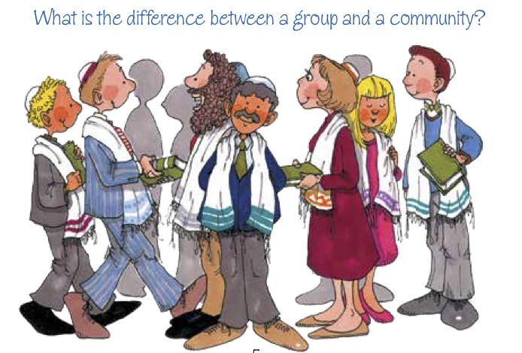
Notes:
Ask the students what they think the difference is. On the next slide, they will be asked to come up with 3 examples of each.

Slide 19


Being a Community

Slide 20
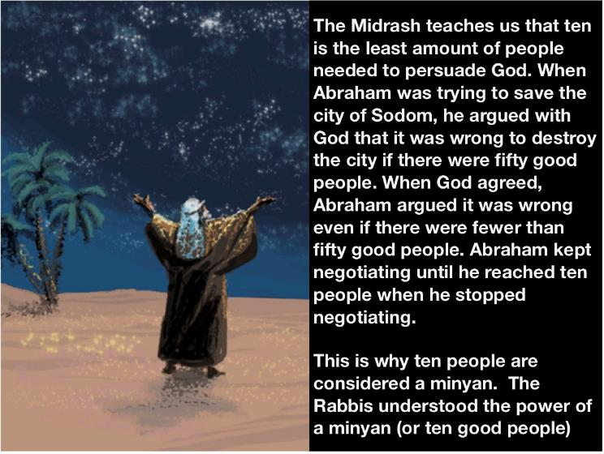
The Power of a Minyan
Notes:
Read the story together. Students can take turns reading to make the story more interactive. Discussion questions follow.

Slide 21
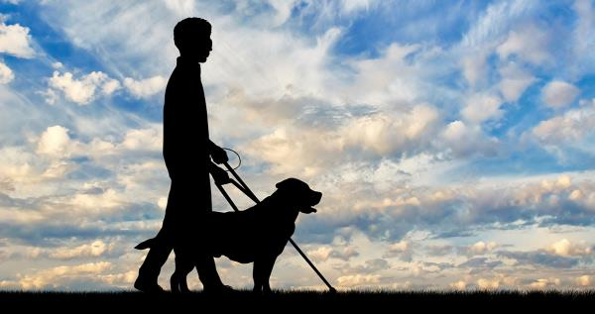
There was a blind Rabbi who was called the Seer of Lublin.
The Seer could not see things through his eyes, but he saw in other ways. One of the Seer's students was a man who lived in a town where he was the only Jew. One week a year the student would leave his farm, ride almost two days on his horse, and then spend a week studying, praying, and being part of the Seer's community.

Slide 22
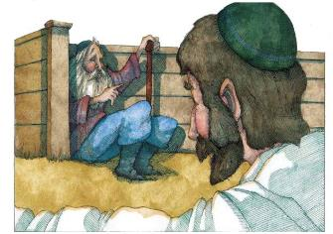
Once he rode into Lublin late on a Thursday afternoon. He went to put his horse away in the stable and found the Seer waiting for him. Almost magically, the blind Seer called him by name and said, "Go home.”
The man said, "But - "
The Seer said, "Go home and get there before Shabbat starts.
The man said, "But it is Thursday afternoon, and my farm is two days away."
The Seer said, "Go."
The man had no choice. He got on his tired horse and rode through the night.

Slide 23
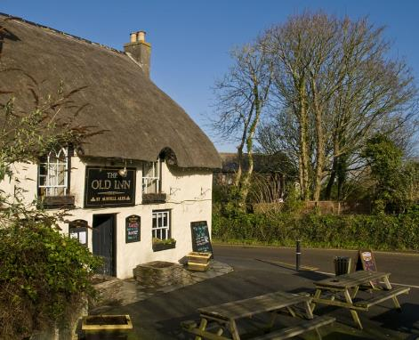
Near morning he came to an inn. The man said, "I am tired. My horse is tired. We will stop for food and water, and then we will rush on." In the inn were nine other Jews. They begged the man to stay with them and be the tenth person in their minyan for Shabbat. He explained that the Seer had told him to go home. He said "Sorry, but no.”

Slide 24
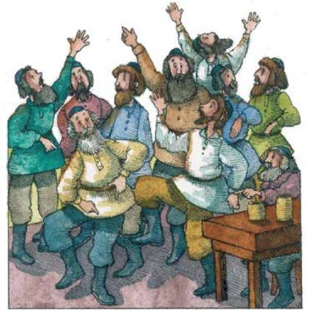
The man ate and drank, but fell asleep and woke just before Shabbat. He panicked when he realized that he was stuck. He became the tenth in their minyan.
It was an amazing Shabbat. When the group sang together it was is if angels were singing with them. When they danced together, it was as if they were dancing in the air. When they studied together, walls of fire surrounded them.

Slide 25

As soon as Shabbat was over, the man got back on his horse and rode through the night to get back to Lublin to apologize. When he got there the Seer was waiting. The Seer called him by name, and said, "You were supposed to die this Shabbat. That is why I wanted you to return home."
The man said, "I am still alive."
The Seer explained, "Sometimes a minyan has more power than a miracle-working Rabbi.”
(From Martin Buber's Tales of the Hasidim)

Slide 26
Discussion Questions
What was the power of the minyan in this story? How did it work?
Why do you think we need a minyan in order to say the Barekhu?

