Slide 1

WEEK 3
Torah Aura Decoding:
ל
Meet the (Lamed)
לָמֶד

Slide 2
Welcome!
בְּרוּכִים הַבָּאִים
שׁ
תּ
בּ
Welcome
Activity 1
Activity 2
Let’s Review!
אבּבגדהוזחטיכּכךלמםנןסעפּפףצץקרשׁשׂתּת
Notes:
Introduction and Review
Review the letters Shin, Tav and Bet from the previous lesson.
Then, review Aleph-Bet song.
Play “Aleph-Bet” Song video here:
https://www.youtube.com/watch?v=UiCzoTs1AdE&t=1s
Have students point out each time that the letters Bet, Shin and Tav come up.

Slide 3
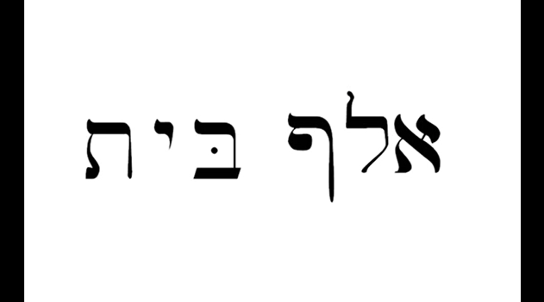
Aleph-Bet Song
Welcome
Activity 1
Activity 2
Activity 3
Wrap Up
אבּבגדהוזחטיכּכךלמםנןסעפּפףצץקרשׁשׂתּת
Notes:
Introduction and Review
Review the letters Shin, Tav and Bet from the previous lesson.
Then, review Aleph-Bet song.
Play “Aleph-Bet” Song video here:
https://www.youtube.com/watch?v=UiCzoTs1AdE&t=1s
Have students point out each time that the letters Bet, Shin and Tav come up.

Slide 4
The Letter (Lamed) “l…”
לָמֶד
ל
l…
אבּבגדהוזחטיכּכךלמםנןסעפּפףצץקרשׁשׂתּת
Notes:
The Letter Lamed, Holom and Reading Practice
Show the letter Lamed slide and have everyone practice saying “l….”

Slide 5
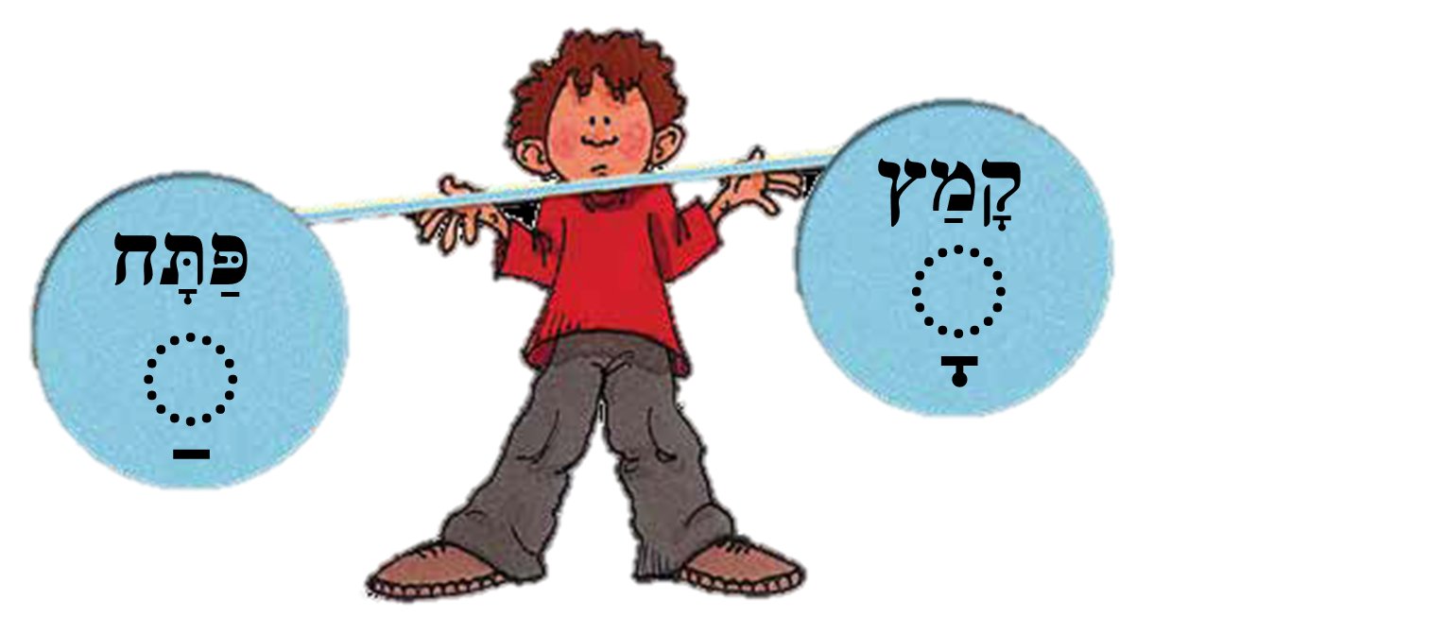
The Vowels קָמַץ and פַּתָּח
לָה לַה
לָה לַה
לָה לַה
לָה לַה
אבּבגדהוזחטיכּכךלמםנןסעפּפףצץקרשׁשׂתּת
Notes:
The Letter Lamed, Holom and Reading Practice
Show the letter Lamed slide and have everyone practice saying “l….”
Then, practice adding in the Kamatz and Patach sounds, to make a “LAH” sound.

Slide 6
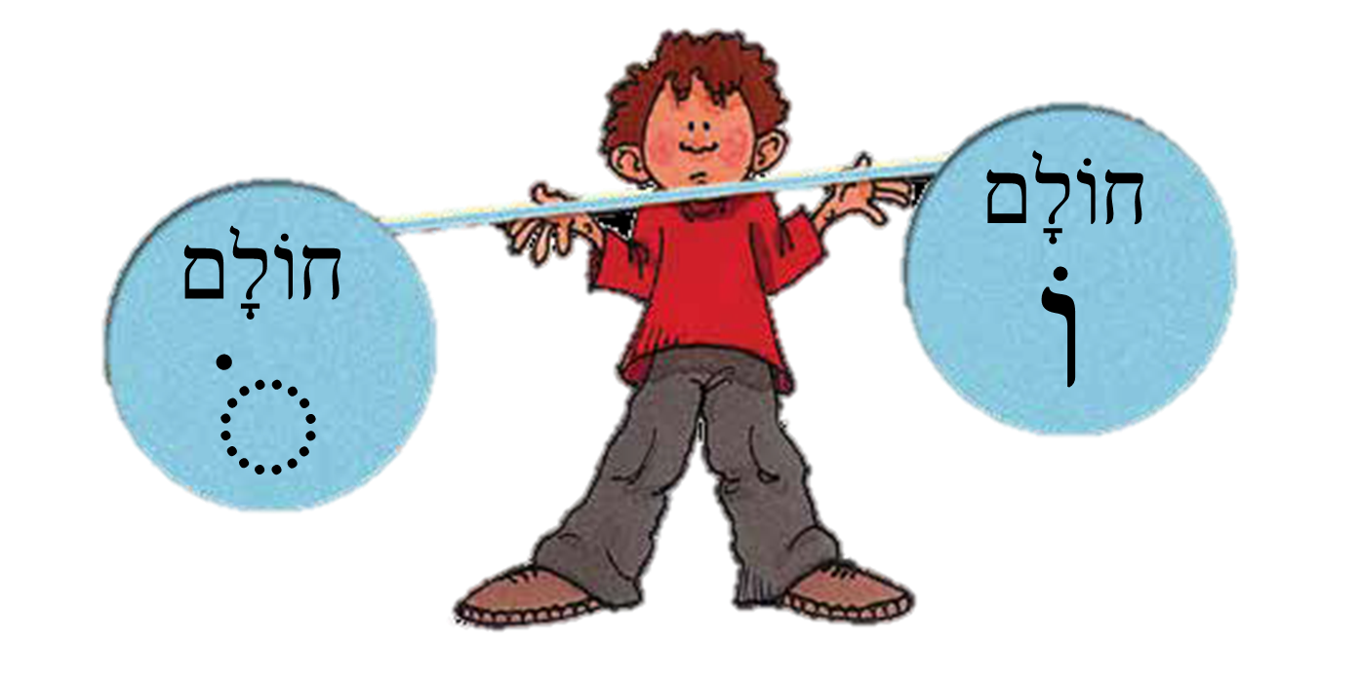
The Vowel חוֹלָם
לוֹ שׁוֹ בּוֹ תּוֹ
אבּבגדהוזחטיכּכךלמםנןסעפּפףצץקרשׁשׂתּת
Notes:
The Letter Lamed, Holom and Reading Practice
Show the letter Lamed slide and have everyone practice saying “l….”
Then, practice adding in the Kamatz and Patach sounds, to make a “LAH” sound.
Introduce the vowel sound holom, which makes an “oh” sound. Make sure students understand how to recognize the different forms of the holom: above a vav and as a high dot above a letter. Have students practice it with the Lamed, Shin, Bet and Tav: lo, sho, bo, to.

Slide 7
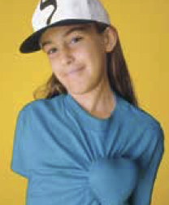
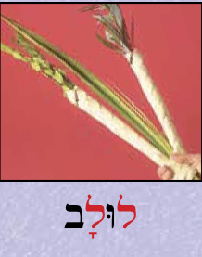
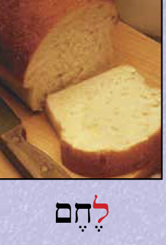
אוּלפָּן
לוּלָב
לֶחֶם
לֵב
אבּבגדהוזחטיכּכךלמםנןסעפּפףצץקרשׁשׂתּת
Notes:
The Letter Lamed, Holom and Reading Practice
Show the letter Lamed slide and have everyone practice saying “l….”
Then, practice adding in the Kamatz and Patach sounds, to make a “LAH” sound.
Introduce the vowel sound holom, which makes an “oh” sound. Make sure students understand how to recognize the different forms of the holom: above a vav and as a high dot above a letter. Have students practice it with the Lamed, Shin, Bet and Tav: lo, sho, bo, to.
Review Ulpan Words on the blackboard and have students repeat the words.
Add the Lamed Ulpan words to the word wall.

Slide 8
ֹ
לָ לַ לָה לַת לַשׁ לָה לָה
.1
לָה בַּל בַּת תָּל שַׁל לָה לָה
.2
שָׁלָ לַשָׁ תָּבָּ בַּתָ לָלַ לָה לָה
.3
לַבָּת לַבָּשׁ בַּבָּל בָּשָׁל בַּבָּשׁ לָה לָה
.4
אבּבגדהוזחטיכּכךלמםנןסעפּפףצץקרשׁשׂתּת
Notes:
The Letter Lamed, Holom and Reading Practice
Have students practice some reading of Hebrew words, using the slideshow. Suggested reading strategy: Teacher Cloze Reading. The teacher begins reading aloud while the students follow along closely. They are prepared to read when the teacher drops out of the reading on one or two words per line of reading.
Then, using the slideshow projected on the whiteboard, have students come up one at a time and circle, using board markers:
Every Shin in blue
Every Bet in yellow
Every Tav in green
Every Lamed in red
Alternatively, an action can be added for each letter instead of circling the letters. For example, as each Shin is read, clap your hands. As each Bet is read, stamp your feet and so on.

Slide 9
ֹ
לָלָה שָׁלָה שַׁבָּל שַׁבָּת שָׁתָל לָה לָה
.1
בַּבָּל בַּבָּשׁ לַבָּשׁ לַבָּת בָּשָׁל לַבָּשׁ לָה לָה
.2
שַׁ בָּת שַׁבָּת לָה בָּ שָׁל בָּשָׁל לָה
.3
שָׁ תַל שָׁתַל לָה לַ בַּת לַבַּת לָה לָה
.4
אבּבגדהוזחטיכּכךלמםנןסעפּפףצץקרשׁשׂתּת
Notes:
The Letter Lamed, Holom and Reading Practice
Have students practice some reading of Hebrew words, using the slideshow. Suggested reading strategy: Teacher Cloze Reading. The teacher begins reading aloud while the students follow along closely. They are prepared to read when the teacher drops out of the reading on one or two words per line of reading.
Then, using the slideshow projected on the whiteboard, have students come up one at a time and circle, using board markers:
Every Shin in blue
Every Bet in yellow
Every Tav in green
Every Lamed in red
Alternatively, an action can be added for each letter instead of circling the letters. For example, as each Shin is read, clap your hands. As each Bet is read, stamp your feet and so on.

Slide 10
לוֹ = לוֹא
לוֹ = לוֹא
לוֹ לוֹא בּוֹ בּוֹא שׁוֹ תּוֹא לוֹ
בּוֹ לוֹא שׁוֹ לוֹ תּוֹא בּוֹא תּוֹ
תּוֹ שׁוֹא בּוֹ לוֹ בּוֹא לוֹא לוֹ
שׁוֹא תּוֹא לוֹ בּוֹ תּוֹלָה בּוֹשָׁה
לוֹ לוֹא בּוֹ בּוֹא שׁוֹ תּוֹא לוֹ
.1
בּוֹ לוֹא שׁוֹ לוֹ תּוֹא בּוֹא תּוֹ
.2
תּוֹ שׁוֹא בּוֹ לוֹ בּוֹא לוֹא לוֹ
.3
שׁוֹא תּוֹא לוֹ בּוֹ תּוֹלָה בּוֹשָׁה
.4
אבּבגדהוזחטיכּכךלמםנןסעפּפףצץקרשׁשׂתּת
Notes:
The Letter Lamed, Holom and Reading Practice
Have students practice some reading of Hebrew words, using the slideshow. Suggested reading strategy: Teacher Cloze Reading. The teacher begins reading aloud while the students follow along closely. They are prepared to read when the teacher drops out of the reading on one or two words per line of reading.
Then, using the slideshow projected on the whiteboard, have students come up one at a time and circle, using board markers:
Every Shin in blue
Every Bet in yellow
Every Tav in green
Every Lamed in red
Alternatively, an action can be added for each letter instead of circling the letters. For example, as each Shin is read, clap your hands. As each Bet is read, stamp your feet and so on.

Slide 11
ֹ
לָ לָה לוֹא לַה לַ לוֹא
לוֹ לוֹא בּוֹא בּוֹ שׁוֹ שׁוֹא לוֹא
תָּ תּוֹ תָּה בַּת לַבּ תּוֹל בּוֹל
שׁוֹ תָה שׁוֹתָה בּוֹ שָׁה בּוֹשָׁה שׁוֹשָׁה
.1
.2
.3
.4
אבּבגדהוזחטיכּכךלמםנןסעפּפףצץקרשׁשּׂת
Notes:
The Letter Lamed, Holom and Reading Practice
Have students practice some reading of Hebrew words, using the slideshow. Suggested reading strategy: Teacher Cloze Reading. The teacher begins reading aloud while the students follow along closely. They are prepared to read when the teacher drops out of the reading on one or two words per line of reading.
Then, using the slideshow projected on the whiteboard, have students come up one at a time and circle, using board markers:
Every Shin in blue
Every Bet in yellow
Every Tav in green
Every Lamed in red
Alternatively, an action can be added for each letter instead of circling the letters. For example, as each Shin is read, clap your hands. As each Bet is read, stamp your feet and so on.

Slide 12
ֹ
תּוֹ לָה תּוֹלָה בַּ לָשׁ בָּלַשׁ בּוֹלָשׁ
תּוֹלָה שׁוֹתָה בָּלַשׁ לוֹא בּוֹשׁה שַׁבָּת
שַׁבָּת בַּ שַׁ בָּת בַּשַׁבָּת שַׁבָּת
.5
.6
.7
אבּבגדהוזחטיכּכךלמםנןסעפּפףצץקרשׁשׂתּת
Notes:
The Letter Lamed, Holom and Reading Practice
Have students practice some reading of Hebrew words, using the slideshow. Suggested reading strategy: Teacher Cloze Reading. The teacher begins reading aloud while the students follow along closely. They are prepared to read when the teacher drops out of the reading on one or two words per line of reading.
Then, using the slideshow projected on the whiteboard, have students come up one at a time and circle, using board markers:
Every Shin in blue
Every Bet in yellow
Every Tav in green
Every Lamed in red
Alternatively, an action can be added for each letter instead of circling the letters. For example, as each Shin is read, clap your hands. As each Bet is read, stamp your feet and so on.

Slide 13
לָ = לָה = לָא
לוֹ = לוֹא
לוֹ לוֹא בּוֹ בּוֹא שׁוֹ תּוֹא לוֹ
בּוֹ לוֹא שׁוֹ לוֹ תּוֹא בּוֹא תּוֹ
תּוֹ שׁוֹא בּוֹ לוֹ בּוֹא לוֹא לוֹ
שׁוֹא תּוֹא לוֹ בּוֹ תּוֹלָה בּוֹשָׁה
לָ לָא לָה בּוֹא תָּא שׁוֹ
.1
בָּא בַּת שָׁא שׁוֹא תּוֹא לָא
.2
תַּ תּוֹ תָּל תּוֹל בּוֹ בּא
.3
לָבּוֹא שַׁבָּשׁ בּוֹא לוֹא
.4
אבּבגדהוזחטיכּכךלמםנןסעפּפףצץקרשׁשׂתּת
Notes:
The Letter Lamed, Holom and Reading Practice
Have students practice some reading of Hebrew words, using the slideshow. Suggested reading strategy: Teacher Cloze Reading. The teacher begins reading aloud while the students follow along closely. They are prepared to read when the teacher drops out of the reading on one or two words per line of reading.
Then, using the slideshow projected on the whiteboard, have students come up one at a time and circle, using board markers:
Every Shin in blue
Every Bet in yellow
Every Tav in green
Every Lamed in red
Alternatively, an action can be added for each letter instead of circling the letters. For example, as each Shin is read, clap your hands. As each Bet is read, stamp your feet and so on.

Slide 14
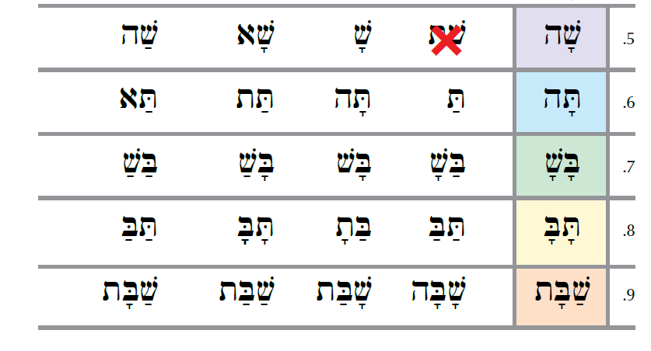
Cross Out Sounds that Don’t Match
This was in the PDF but not sure if it is part of lesson plan. I just threw it here.
אבּבגדהוזחטיכּכךלמםנןסעפּפףצץקרשׁשׂתּת
Notes:
Vowel Sound Matching Game
Have students break up into pairs or small groups and play the “Kamatz/Patach/Holom Memory Matching Game.”
Have students play according to the memory game rules (for more information, see here: https://www.eduplace.com/ss/act/rules.html) to review and practice the vowel sounds of Kamatz, Patach and Holom with the letters learned so far.
Note: Make sure to print both pages of the “Kamatz Patach Holom Matching Game” and print on cardstock. Cut into game cards ahead of time.
For younger students: Only print page 1 of the matching game, for a simpler and quicker game.

Slide 15
Vowel Sound Matching Game
אבּבגדהוזחטיכּכךלמםנןסעפּפףצץקרשׁשׂתּת
Notes:
Vowel Sound Matching Game
Have students break up into pairs or small groups and play the “Kamatz/Patach/Holom Memory Matching Game.”
Have students play according to the memory game rules (for more information, see here: https://www.eduplace.com/ss/act/rules.html) to review and practice the vowel sounds of Kamatz, Patach and Holom with the letters learned so far.
Note: Make sure to print both pages of the “Kamatz Patach Holom Matching Game” and print on cardstock. Cut into game cards ahead of time.
For younger students: Only print page 1 of the matching game, for a simpler and quicker game.

Slide 16
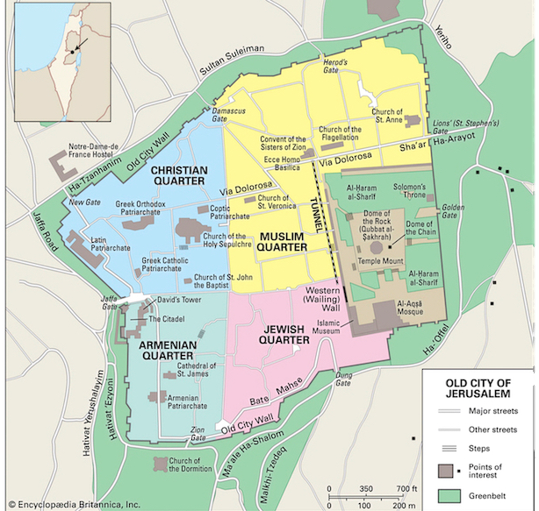
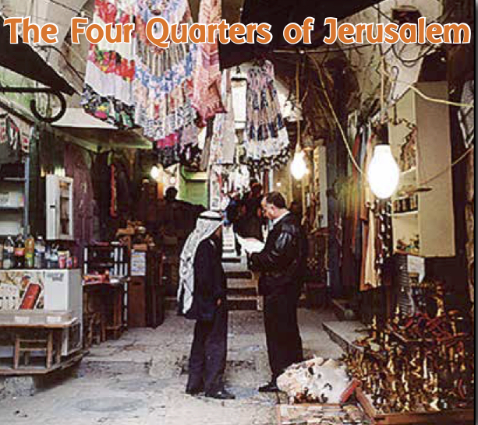
The Four Quarters of the Old City
אבּבגדהוזחטיכּכךלמםנןסעפּפףצץקרשׁשׂתּת
Notes:
The Four Quarters of the Old City
Have students take turns reading about the four quarters of the Old City of Jerusalem.
Teach students to say “ani rotzeh/rotzah” רוצה אני (m/f) for “I want…” and “l’rot” לראות - “to see”. Write these phrases on the blackboard for students to see and practice.
Remind students what we have studied about Jerusalem in the past few lessons as well. Then, have the students go around and share what they would want to see and explore in the Old City, starting with “Ani rotzeh/rotzah l’rot……”
לראות רוצה אני

Slide 17

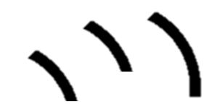

אֲנִי רוֹצֶה / רוֹצָה לִרְאוֹת
אֲנִי רוֹצֶה
לִרְאוֹת
אֲנִי רוֹצָה
לִרְאוֹת
אבּבגדהוזחטיכּכךלמםנןסעפּפףצץקרשׁשׂתּת
Notes:
The Four Quarters of the Old City
Have students take turns reading about the four quarters of the Old City of Jerusalem.
Teach students to say “ani rotzeh/rotzah” רוצה אני (m/f) for “I want…” and “l’rot” לראות - “to see”. Write these phrases on the blackboard for students to see and practice.
Remind students what we have studied about Jerusalem in the past few lessons as well. Then, have the students go around and share what they would want to see and explore in the Old City, starting with “Ani rotzeh/rotzah l’rot……”
לראות רוצה אני

Slide 18
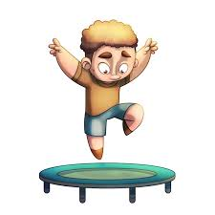
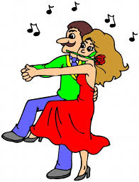
TPR Walk/Stop Game
לִרְקוֹד
לִקְפּוֹץ
אבּבגדהוזחטיכּכךלמםנןסעפּפףצץקרשׁשׂתּת
Notes:
TPR Walk/Stop Game
Add in new words “lirkod” לרקוד (to dance) and “l’kfotz” לקפוץ (to jump)
Write the new words on the blackboard and explain their meanings.
Then, have students play “walk and stop” using these new words, as well as the previous TPR words.
First watch this explanatory video here: https://www.youtube.com/watch?v=a72goyDtjeI&feature=youtu.be
then play a modified version of this game, in which Hebrew command words are used instead (remove the name/clap component). The goal of the game is to get students to pay attention, so that even when the words have an opposite meaning, they will still follow the rules

Slide 19
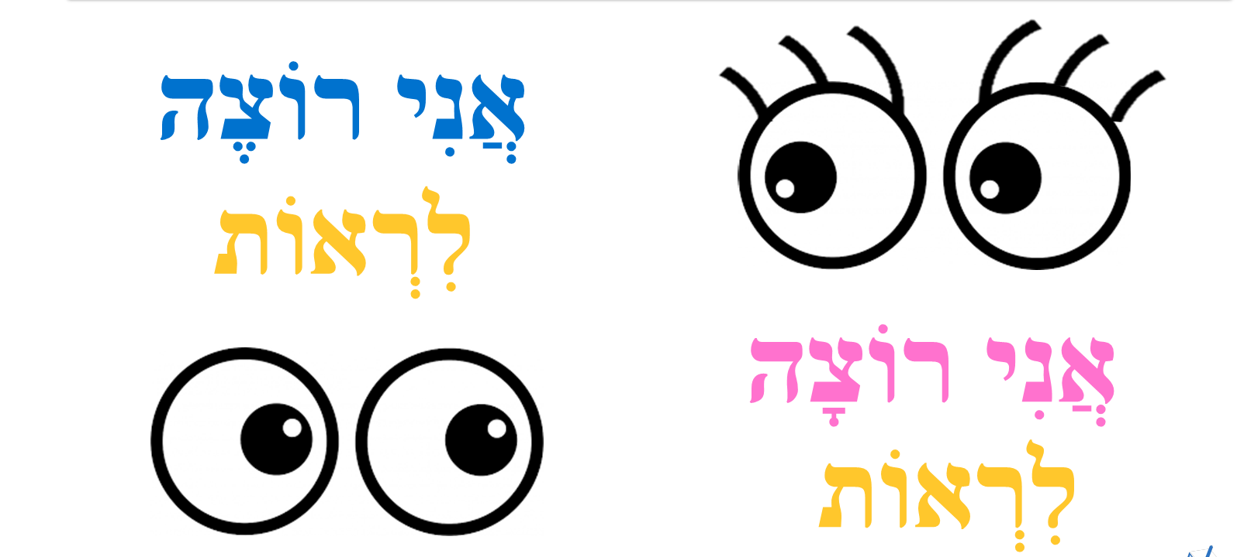
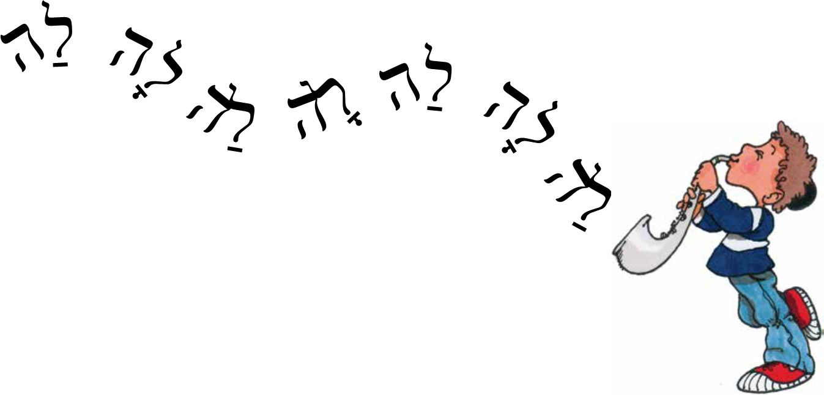
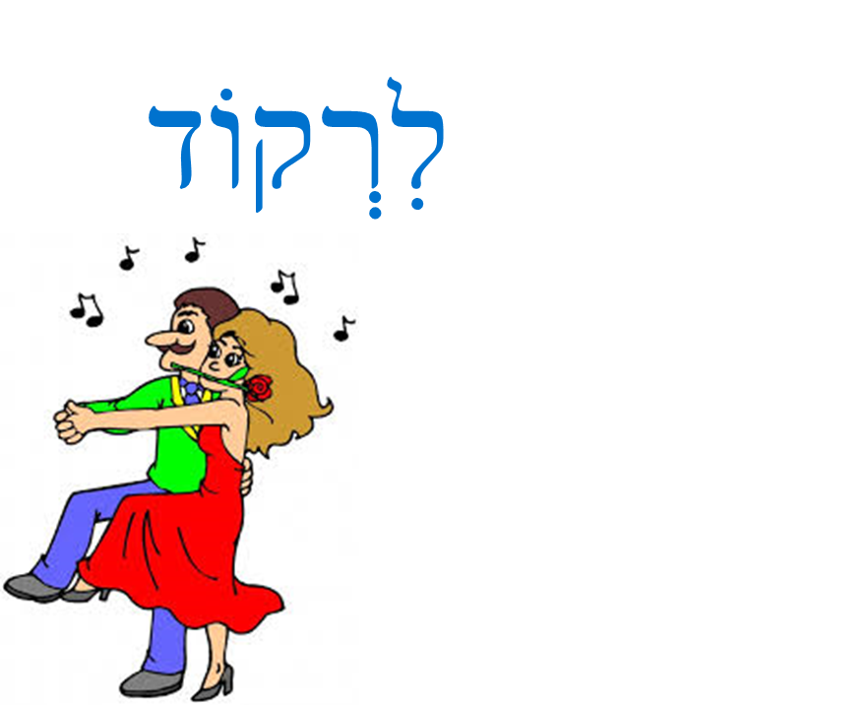
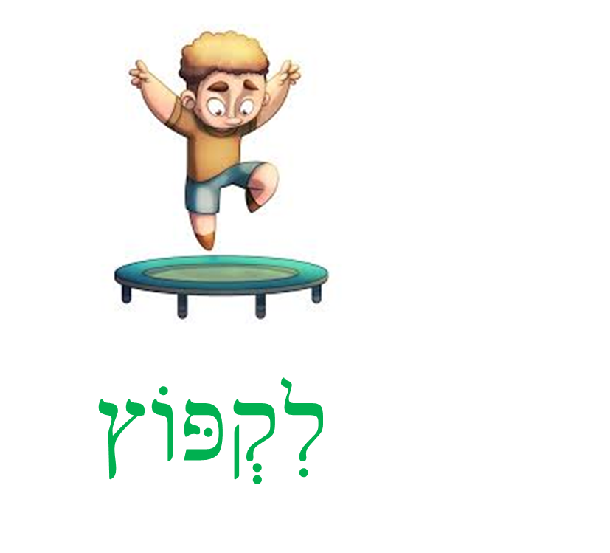
Wrap Up and שָׁלוֹם
Shalom
אבּבגדהוזחטיכּכךלמםנןסעפּפףצץקרשׁשׂתּת
Notes:
Wrap Up and “Shalom”
Review the “L..”, “LOH” and “LAH” sounds.
Send students off saying “Shalom” and sing “Shalom, Cheverim”:
https://www.youtube.com/watch?v=ImAIzsLUq5g

Slide 20
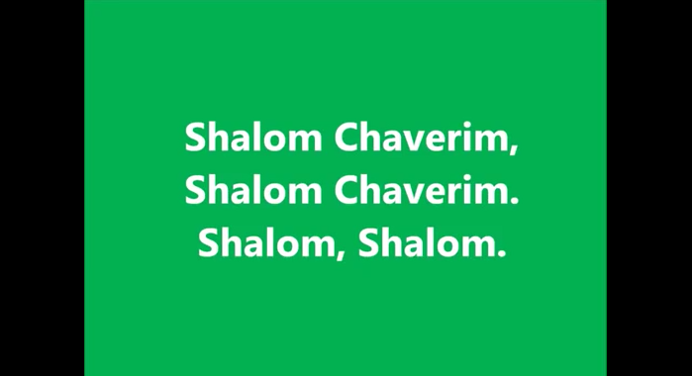
Shalom Chaverim Song
אבּבגדהוזחטיכּכךלמםנןסעפּפףצץקרשׁשׂתּת

